Slide 1
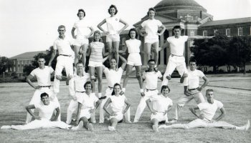

Slide 2
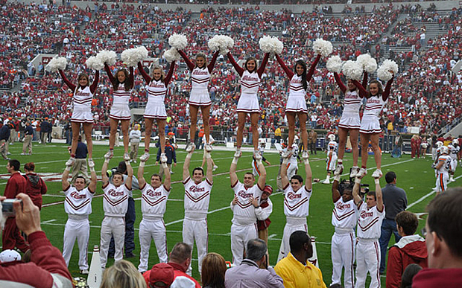

Slide 3
Cheerleading ranges from yelling to intense physical activity for sports team motivation, audience entertainment or competition based upon organized routines. The routines usually range anywhere from one to three minutes, which may contain many components of tumbling, dance, jumps, cheers and stunting in order to direct spectators of events to cheer for sports teams at games or to participate in cheerleading competitions.
The yellers, dancers and athletes involved in cheerleading are called cheerleaders. Cheerleading originated in the United States, and remains predominantly American, with an estimated 1.5 million participants in all-star cheerleading.
https://www.youtube.com/watch?v=MduMjuxuIac
https://www.youtube.com/watch?v=4vpzifkoZHI

Slide 4
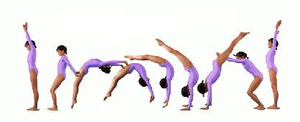
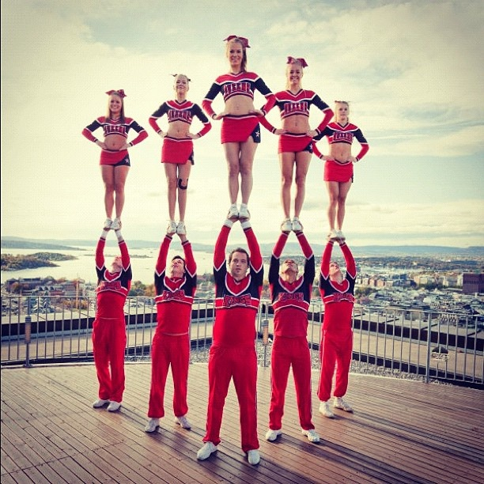
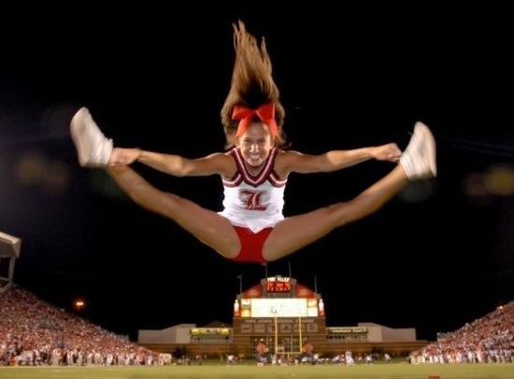
STUNTING
TUMBLING
JUMP

Slide 5
THE CHEER
cheerleading started as an all-male activity. As early as 1877, Princeton University had a "Princeton Cheer”.
This cheer was yelled from the stands by students at games, as well as by the baseball and football athletes themselves.
The cheer, "Hurrah! Hurrah! Hurrah! Tiger! S-s-s-t! Boom! A-h-h-h!" remains in use with slight modifications today and is now referred to as the "Locomotive".
the University of Minnesota organized a "yell leader" squad of six male students.
In 1903 the first cheerleading fraternity, Gamma Sigma, was founded.

Slide 6
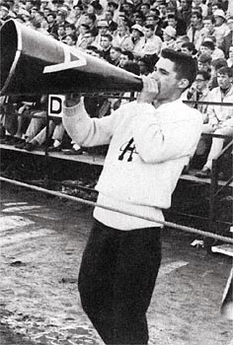
THE CHEER: , "Hurrah! Hurrah! Hurrah! Tiger! S-s-s-t! Boom! A-h-h-h!"

Slide 7
A man’s sport
Women finally joined cheerleading in 1923 and began to dominate the sport during World War II when most of the men left to fight. They were not yet allowed to compete in collegiate sports, but were permitted to join cheering squads.
In 1975 ninety-five percent of cheerleaders within America were female.
In 2005, overall statistics show around 97% of all modern cheerleading participants are female, although at the collegiate level, cheerleading is co-ed with about 50% of participants being male

Slide 8
Cheerleading association and the show
In 1948, Lawrence "Herkie" Herkimer, of Dallas, Texas, a former cheerleader at Southern Methodist University, formed the National Cheerleaders Association (NCA) in order to hold clinics for cheerleading.
In 1949, The National Cheerleaders Association held its first clinic in Huntsville, Texas, with 52 girls in attendance. Herkimer contributed many firsts to cheerleading: cheerleading uniform , herkie (where one leg is bent towards the ground as if kneeling and the other is out to the side as high as it will stretch in the toe-touch position), and "Spirit Stick".
In 1965, Fred Gastoff invented the vinyl pom-pon, which was introduced into competitions by the International Cheerleading Foundation (now the World Cheerleading Association or WCA).
In 1978, America was introduced to competitive cheerleading by the first broadcast of Collegiate Cheerleading Championships on CBS.

Slide 9
All star (USASF: US All Star Federation)
NBA Cheerleading league: The National Basketball Association (NBA) is a professional basketball league with teams in the United States and Canada. Each team has a squad of dancers for cheerleading.
NFL chearleading league.

